Slide 1
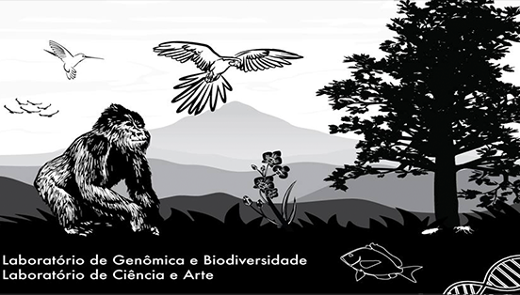


MITOFREE: AN AUTOMATED PIPELINE FOR MITOGENOME ASSEMBLY, ANNOTATION AND PHYLOGENOMIC ANALYSIS USING PUBLIC DATA
Gabriel Alves Vieira & Francisco Prosdocimi
Laboratório de Genômica e Biodiversidade
Instituto de Bioquímica Médica Leopoldo de Meis
Universidade Federal do Rio de Janeiro

Slide 2

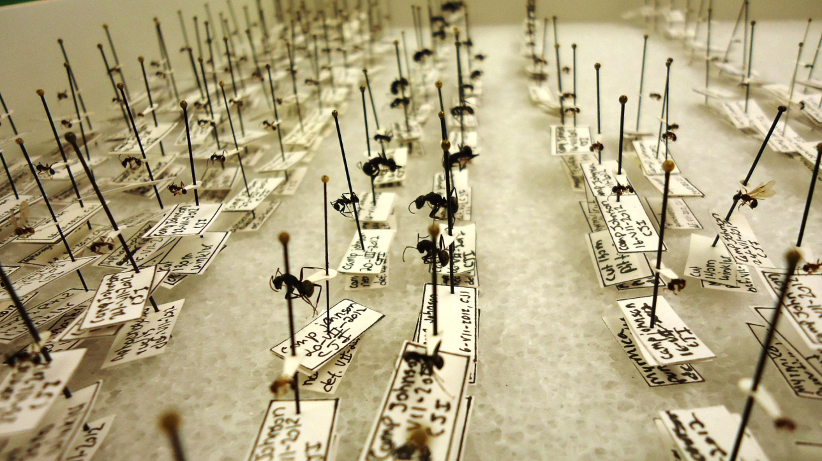
Summary
NGS and public data
Sequence Read Archive (SRA)
Public data and mitogenomics
MitoFree

Slide 3
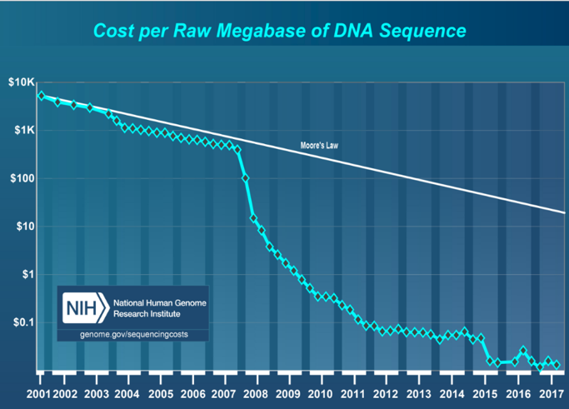
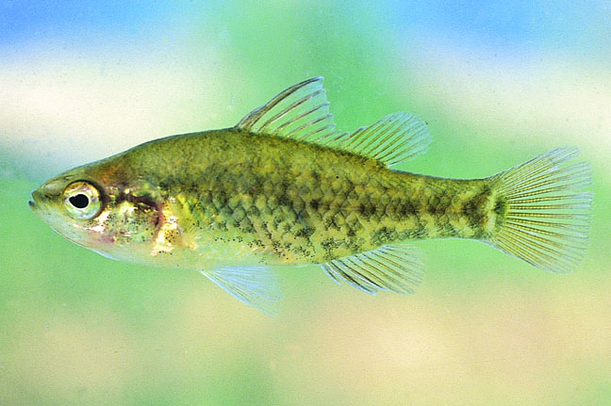

NGS and public data
Next-Generation Sequencing (NGS)
↑ genomic data produced
↓ cost per sequenced base
Journals: Incentivates raw data publication
Reproducibility
Growth of public sequencing databases

Slide 4
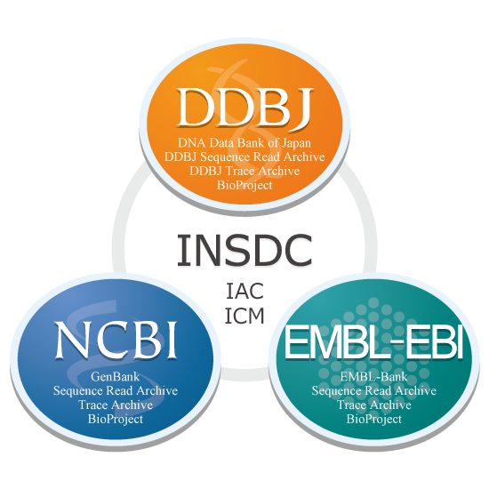

Sequence Read Archive (SRA)
Part of an international colaboration (INSDC)
3 databases:
SRA: NCBI Sequence Read Archive
ERA: EBI Sequence Read Archive
DRA: DDBJ Sequence Read Archive
Synchronized
Several types of sequencing data:
DNA-seq; Bisulfite-seq; RNA-seq...
Enormous potential for “recycling”
Scientific advances at low costs

Slide 5
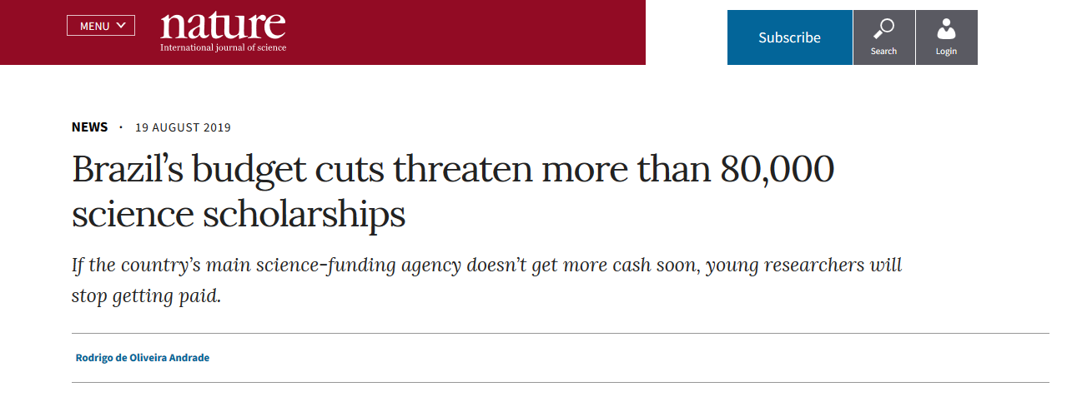
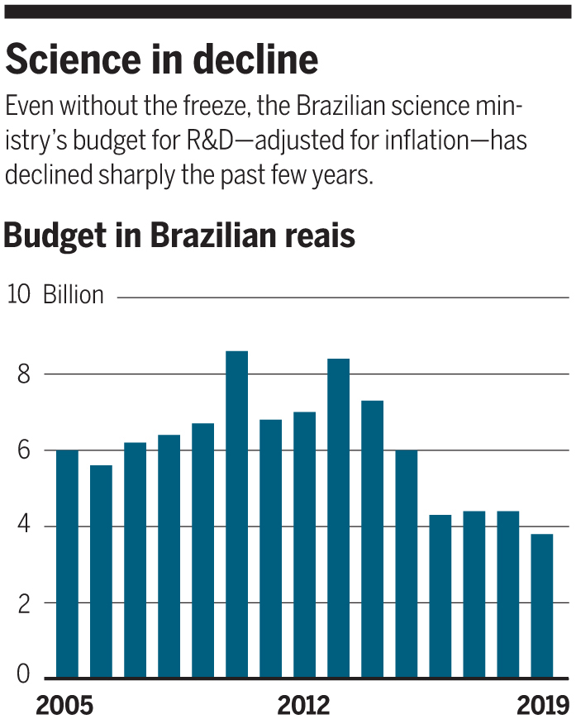
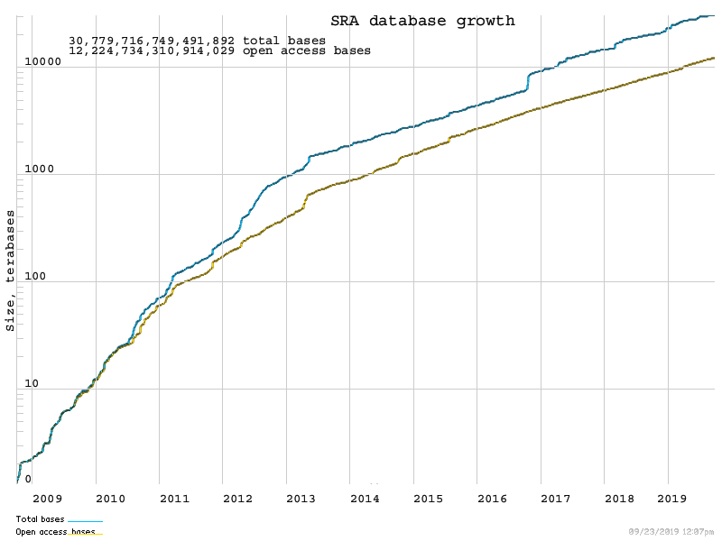
Brazil: ↓ Scientific funding
↑ Public sequencing data
How can these datasets foster new research?

Slide 6
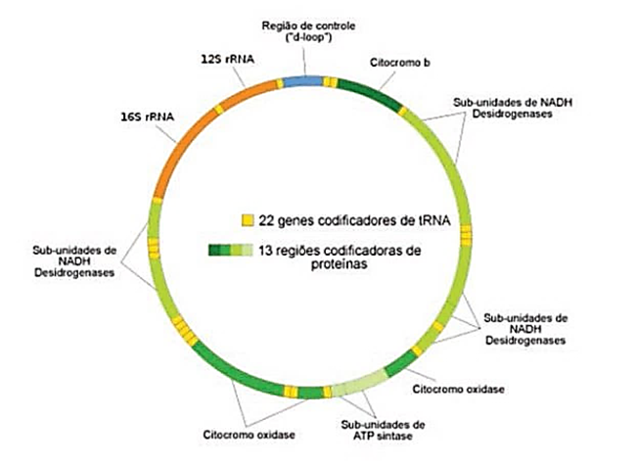
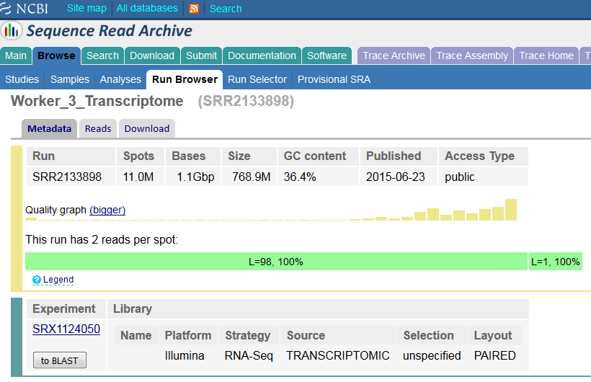
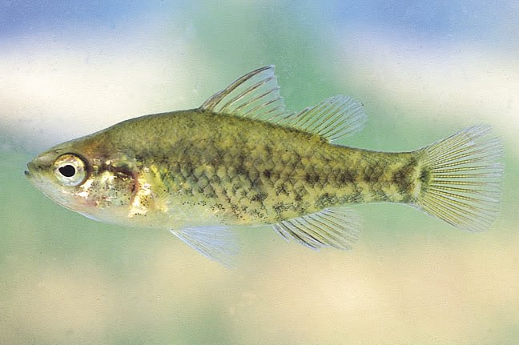
Public data and mitogenomics
Data used to answer a specific question
Not related to the mitogenome
Sequencing
Mitochondrial sequences often present
1 in each 200-1000 sequences is mitochondrial
Many species with public data available and no mitogenome published
Most dataset types can be used to assemble the mitogenome
Phylogenetics (Krzemińska et al., 2017)
Phylogeography (Fields et al., 2018)
Populational genetics (Kilinç et al., 2018)
Conservation (Rosel et al., 2017)

Slide 7
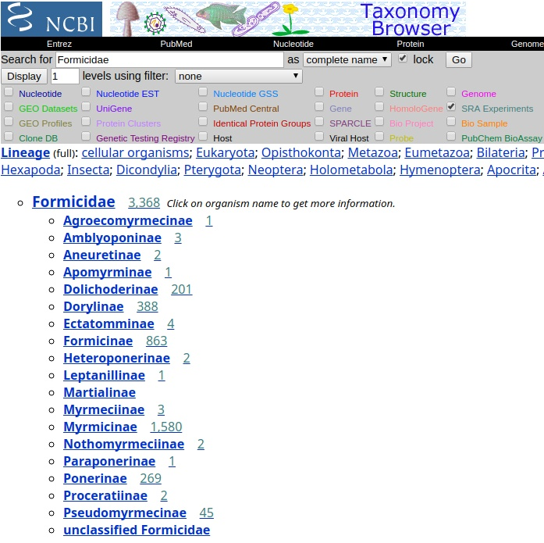
Ants (Hymenoptera: Formicidae)
More than 13000 spp.
Huge amount of genomic sequencing data for the clade
≈ 3.91 Terabytes
35 complete mitogenomes
Why not use this data?

Slide 8
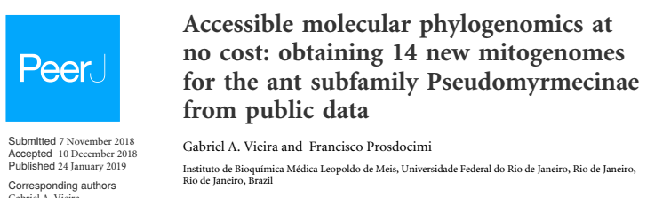
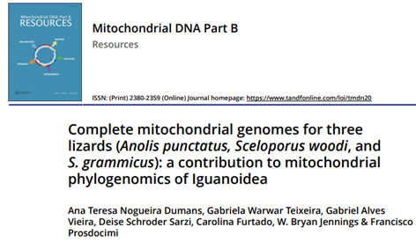

Slide 9
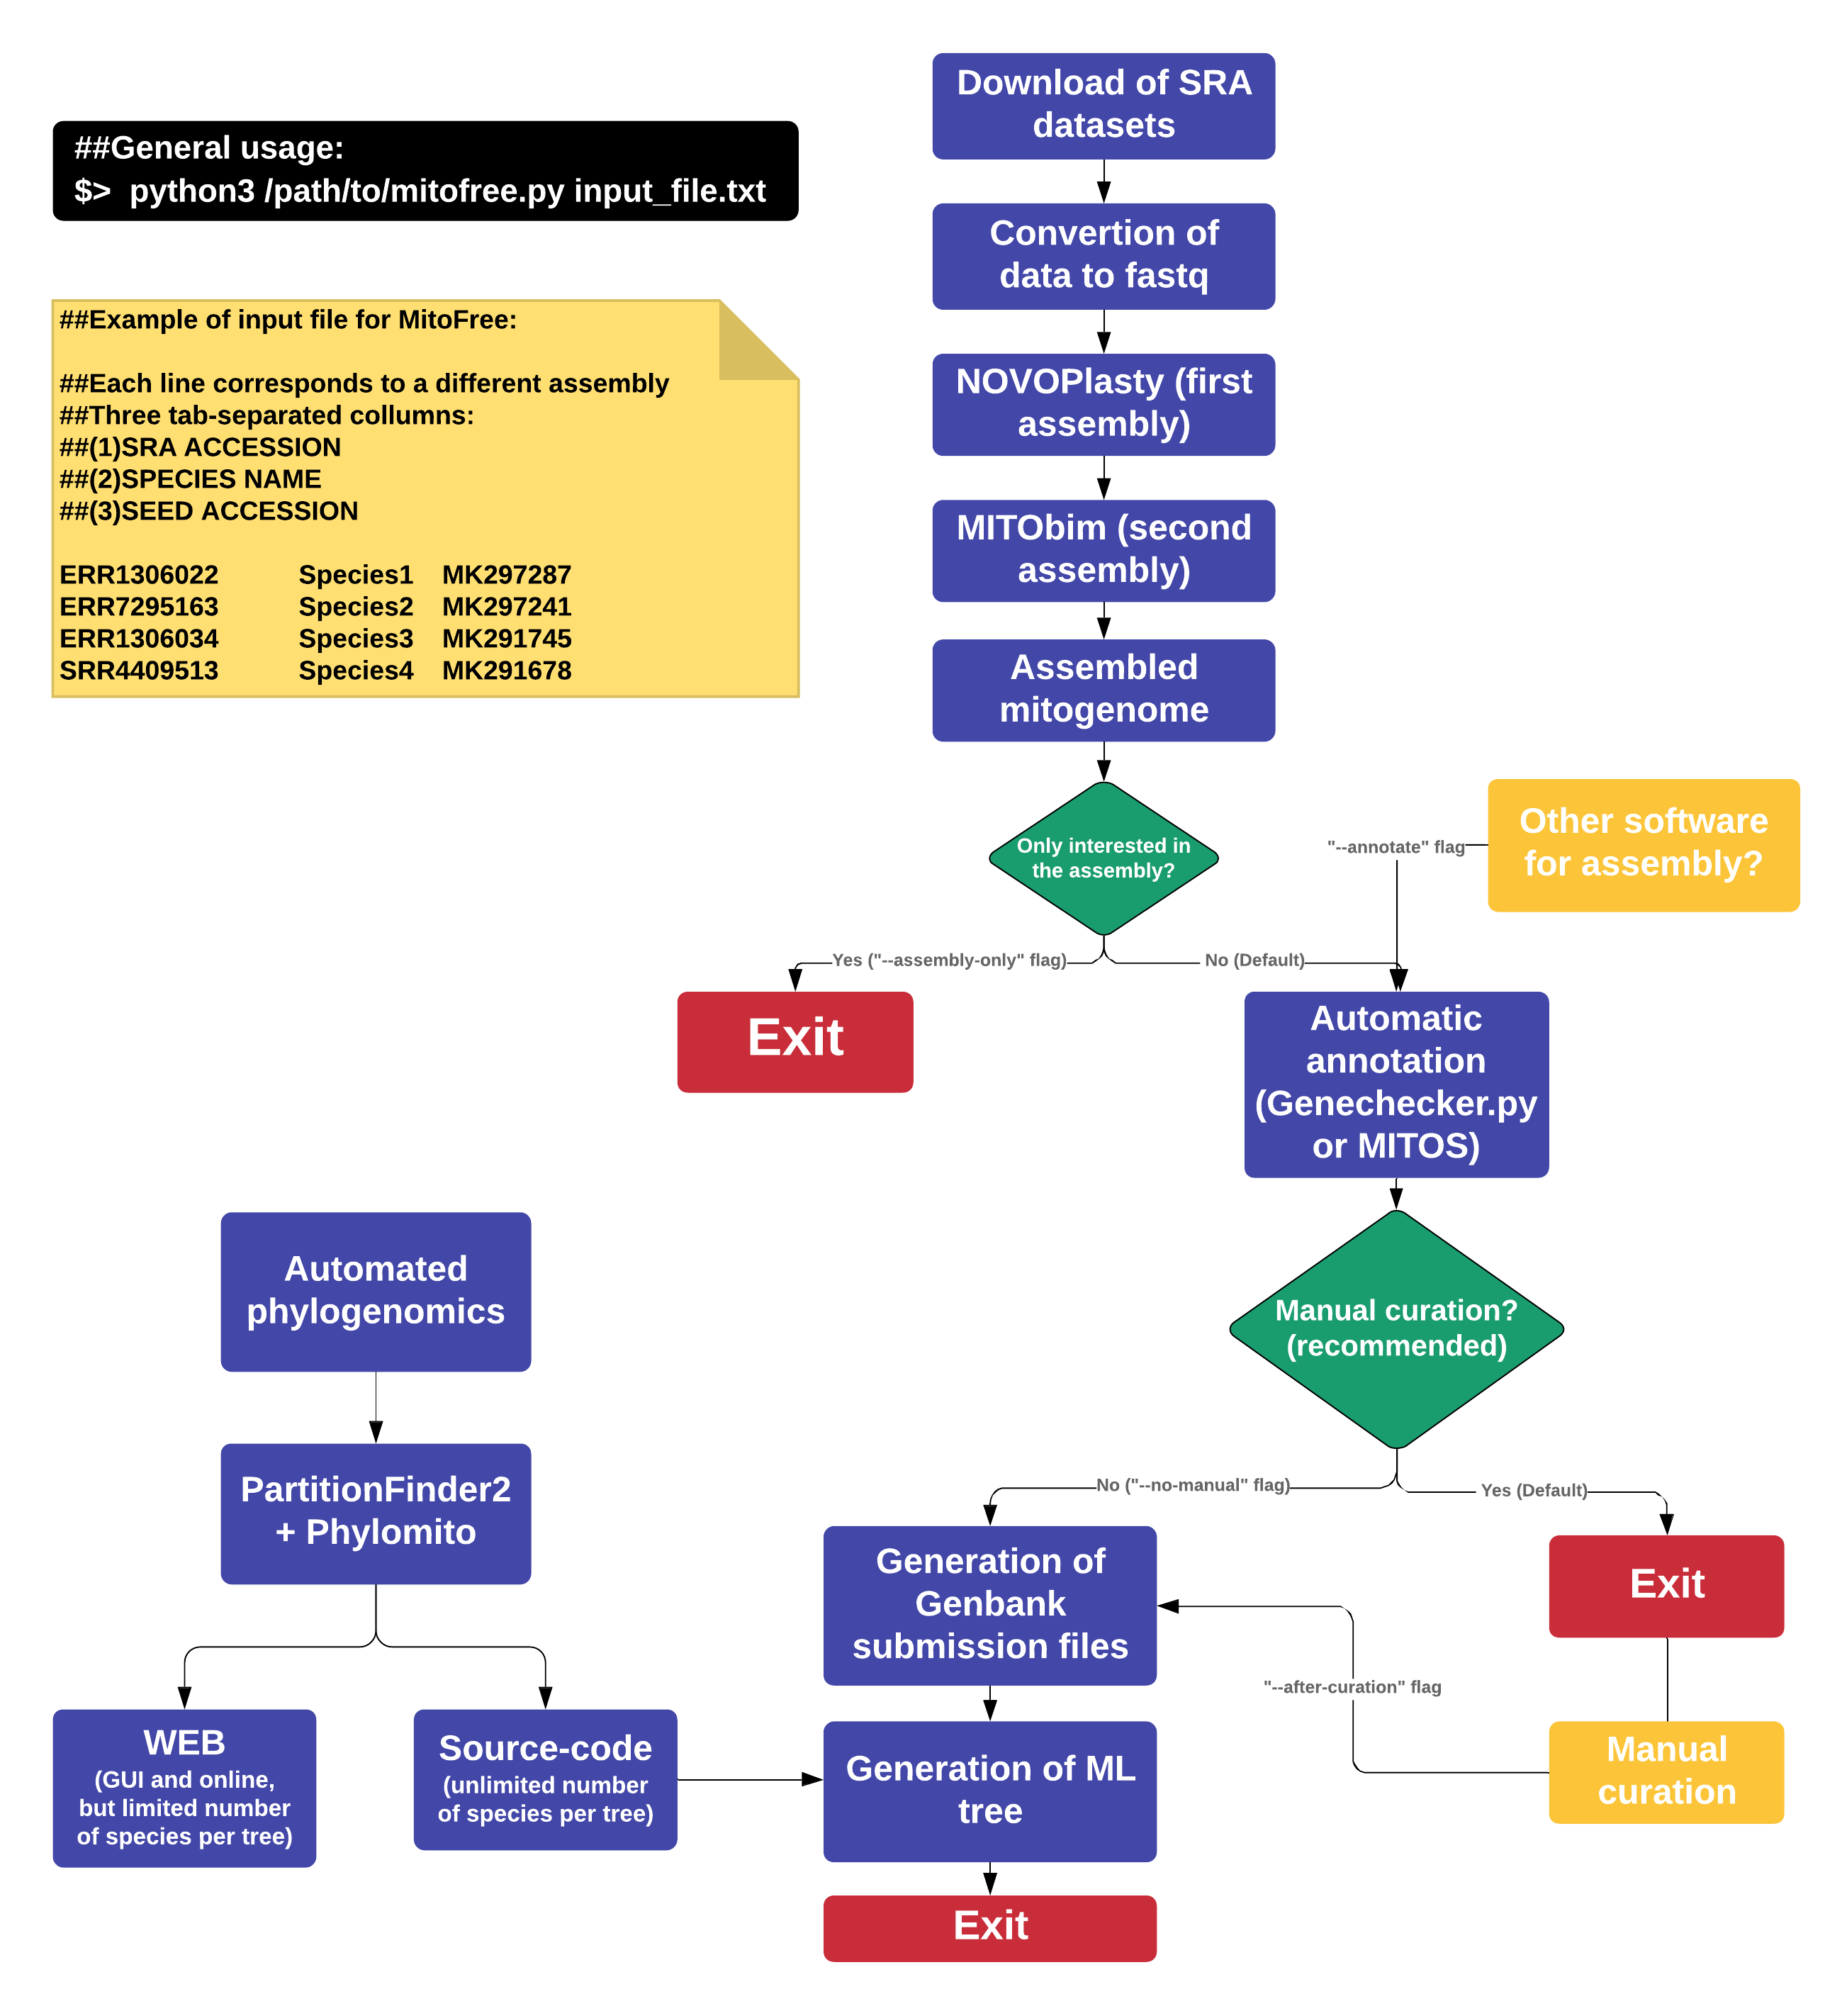
Mitogenomics: is it accessible?
Two major problems:
Lack of bioinformatics expertise
Lack of robust servers for mitogenome assembly
MitoFree:
Simple command-line interface and input file
Low RAM requirements
Optimized assemblers - organelle assembly

Slide 10
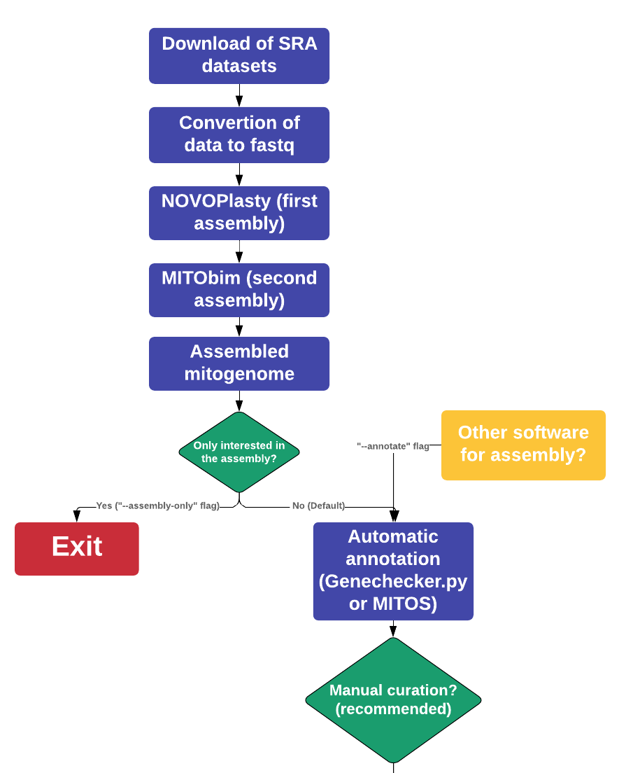
ALGORITHM (First half)

Slide 11
ALGORITHM (Second half)

Slide 12
ALGORITHM (Second half)

Slide 13
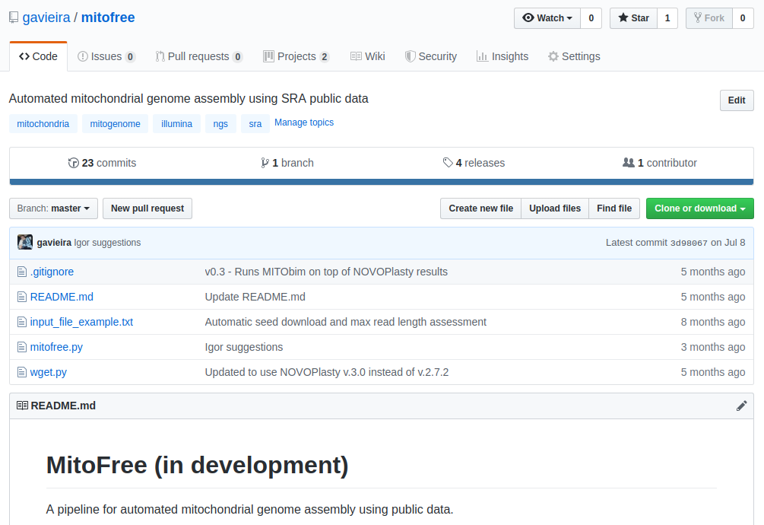

MitoFree
Python3
Several dependencies
Biopython
Third-party software
Future - Single package
Beta version
Downloads and assembles mitogenomes using public data
Available for download (google it!)
https://github.com/gavieira/mitofree

Slide 14


Conclusion
Free datasets available
Species with no mitogenome described
Mitogenomes
Ubiquitous in sequencing datasets
Versatile in analyses
NO/LOW BUDGET MITOGENOMICS
No sequencing costs
Free bioinformatics software
No need for supercomputers
MitoFree hopefully will:
Highlight the untapped potential of public sequencing databases
Make mitogenomics using public data more acessible
↑ mitogenomes : Evolution and Conservation (Non-model)

Slide 15
REFERENCES
Fields, Peter D., et al. "Mitogenome phylogeographic analysis of a planktonic
crustacean." Molecular Phylogenetics and Evolution (2018).
Kılınç, Gülşah Merve, et al. "Investigating Holocene human population history in North
Asia using ancient mitogenomes." Scientific reports 8.1 (2018): 8969.
Krzemińska, Urszula, et al. "Population mitogenomics provides insights into
evolutionary history, source of invasions and diversifying selection in the House Crow (Corvus splendens)." Heredity 120.4 (2018): 296.
Rosel, Patricia E., et al. "Examining metrics and magnitudes of molecular genetic
differentiation used to delimit cetacean subspecies based on mitochondrial DNA control region sequences." Marine Mammal Science 33.S1 (2017): 76-100.

Slide 16

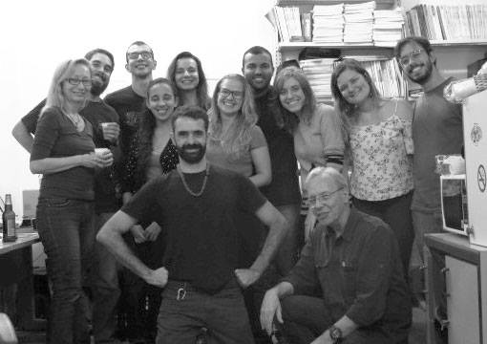




OBRIGADO!
Email: gabriel.vieira@bioqmed.ufrj.br

